Slide 1
Routing for Mobile Hosts

Slide 2
To route a packet to a mobile host, the network first has to find it.
Hosts that never move are said to be stationary.
In case of mobile host we have 2 hosts:
Migratory hosts are basically stationary hosts who move from one fixed site to another from time to time but use the network only when they are physically connected to it.
Roaming hosts actually compute on the run and want to maintain their connections as they move around.
All hosts are assumed to have a permanent home location that never changes.
Hosts also have a permanent home address that can be used to determine their home locations.
In case of wireless network, small areas called wireless cells:
Each area has one or more foreign agents, which are processes that keep track of all mobile hosts visiting the area.
In addition, each area has a home agent, which keeps track of hosts whose home is in the area, but who are currently visiting another area.

Slide 3
When a new host enters an area, either by connecting to it (e.g., plugging into the LAN) or just wandering into the cell, his computer must register itself with the foreign agent there.
The registration procedure typically works like this:
Periodically, each foreign agent broadcasts a packet announcing its existence and address. A newly-arrived mobile host may wait for one of these messages, but if none arrives quickly enough, the mobile host can broadcast a packet saying: Are there any foreign agents around?
The mobile host registers with the foreign agent, giving its home address, current data link layer address, and some security information.

Slide 4
The foreign agent contacts the mobile host's home agent and says: One of your hosts is over here. The message from the foreign agent to the home agent contains the foreign agent's network address. It also includes the security information to convince the home agent that the mobile host is really there.
The home agent examines the security information, which contains a timestamp, to prove that it was generated within the past few seconds. If it is ok, it tells the foreign agent to proceed.
When the foreign agent gets the acknowledgement from the home agent, it makes an entry in its tables and informs the mobile host that it is now registered.
When a host leaves an area, that, too, should be announced to allow deregistration, but many users abruptly turn off their computers when done.

Slide 5
Packet routing for mobile hosts
When a packet is sent to a mobile host, it is routed to the host's home LAN are intercepted by the home agent there.
The home agent then looks up the mobile host's new (temporary) location and finds the address of the foreign agent handling the mobile host.
The home agent then does two things:
First, it encapsulates the packet in the payload field of an outer packet and sends the latter to the foreign agent. This mechanism is called tunneling.
After getting the encapsulated packet, the foreign agent removes the original packet from the payload field and sends it to the mobile host as a data link frame.

Slide 6
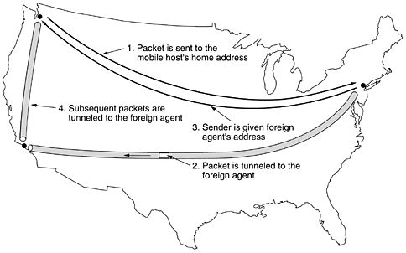
Second, the home agent tells the sender to henceforth send packets to the mobile host by encapsulating them in the payload of packets explicitly addressed to the foreign agent instead of just sending them to the mobile host's home address.
Subsequent packets can now be routed directly to the host via the foreign agent bypassing the home location entirely.

